Slide 1
Employee Data Analysis using Excel
STUDENT NAME: VINCENT NABIL.B
REGISTER NO:122203462
6FF6FE2C44D0940951F43A56AA99EE27
DEPARTMENT: B.com(CS)
COLLEGE:ST. Thomas college of arts & science

Slide 2
PROJECT TITLE
Salary and Compensation Analysis Through Excel Data Modeling

Slide 3


AGENDA
Problem Statement
Project Overview
End Users
Our Solution and Proposition
Dataset Description
Modelling Approach
Results and Discussion
Conclusion
3/21/2024 Annual Review

Slide 4

PROBLEM STATEMENT
1.Overview of salary and compensation analysis.
2.Data-driven decision making.
3.Sources of compensation data(e.g., HR systems ,surveys).
4.Data quality and cleaning considerations.
5.Create a data model for compensation analysis.

Slide 5

PROJECT OVERVIEW
1.Objective:
*Analysis employee compensation data to identify trends,
disparities ,and areas for improvement.
2.Scope:
*Develop an excel data model to analyse and visualize
Compensation trends.
3.Deliverables:
*Interactive dashboards and visulaztion to facilitate
Ongoing monitoring and improvement.

Slide 6

WHO ARE THE END USERS?
1.HR.professionals.
2.Compensation analsts.
3.HR.managers
4.Finance manager.
5.Business leaders.
6.Department managers.
7.Talent acquisition.
8.Employee experience
9.DEI{(diversity,equity,inclusion)}.
10.Data analysts.

Slide 7

OUR SOLUTION AND ITS VALUE PROPOSITION
Value proposition
1.Data-Driven insights unlock hidden patterns and trends in compensation data to inform strategic decision.
2.Strategic business decision support business growth and ndfata-driven compensation insights.
3.Scalability adapt to growing organizational needs and changing market conditions.
4.Improved business outcomes, and employe satification, and market competitiveness.

Slide 8
Dataset Description
1.Unique identifier for each employee.
2.Employee name.
3.Employee’s job title.
4.Department where the employee work.
5.Location(e .g., city, state, country).
6.Date the employee was hired.
7.Employee’s annual benefits amount.
8.Employee’s job grade or level.
{(This dataset can be used to analyse compensation trends, identify disparities and develop strategies to competitiveness)}

Slide 9
THE "WOW" IN OUR SOLUTION
Predictive analytics: Integrating predictive methods to forecast future salary and compensation based on historical data, giving managers a proactive Approach to workplace planning.Automated alerts: the tool can be set up to send automated alerts for critical salary & compensation issues, ensuring that managers are immediately notified when attention needed
3/21/2024 Annual Review
9

Slide 10
MODELLING
In the "Salary and compensation analysis Through excel Data modeling" project, the modelling phase involves setting up the Excel workbook with various tools and techniques to analyse and visualize the data effectively.Here's how each component will be used:
Data FilteringPurpose: To sort and refine the data to focus on specific criteria, such as department, date range, or individual employee pay zone.Implementation: Excel's filtering feature will be applied to datasets, allowing users to easily narrow down the data to view only the relevant information. For example, filtering by department or by employee types.
2. Pivot TablesPurpose: To summarize and analyse large datasets by grouping and aggregating data based on different pay zone metrics.Implementation: Pivot tables will be used to dynamically calculate and display key business unit (KBUs) such as average task completion time, total hours worked, or percentage of targets met. This will allow users to view performance metrics by different categories, like employee, team, or month.
10

Slide 11
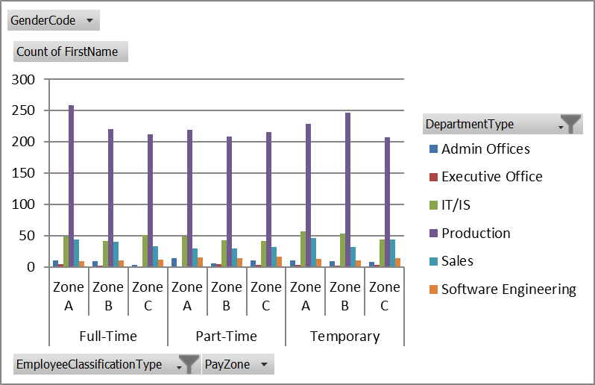
RESULTS
11

Slide 12
conclusion
1.The important of data-driven decision making in compensation
management.
2.It analysis to ensure internal equity and market competitiveness.
3.Exal data modelling in simplifying complex compensation data.
4.Multi factors in compensation analysis, including job title, and
performance rating.
5.Compensation program ultimately driving business success and employee satisfaction.

